Slide 1
COM2067/ COM267
Chapter 5: Structures

Slide 2
Introduction
Nested Structures
Arrays of Structures
Structures And Functions
Self-Referential Structures

Slide 3
Introduction
A structure is in many ways similar to a record.
It stores related information about an entity.
Structure is basically a user-defined data type that can store related information (even of different data types) together.
The major difference between a structure and an array is that an array can store only information of same data type.
A structure is therefore a collection of variables under a single name.
The variables within a structure are of different data types and each has a name that is used to select it from the structure.

Slide 4
Introduction
Structure Declaration
A structure is declared using the keyword struct followed by the structure name.
All the variables of the structure are declared within the structure.
A structure type is generally declared by using the following syntax:
struct struct–name {
data_type var–name;
data_type var–name;
............... };
For example, if we have to define a structure for a student, then the related information for a student probably would be: roll_number, name, course, and fees.
This structure can be declared as:
struct student {
int r_no;
char name[20];
char course[20];
float fees;
};

Slide 5
Introduction
Now the structure has become a user-defined data type.
Each variable name declared within a structure is called a member of the structure.
The structure declaration, however, does not allocate any memory or consume storage space.
It just gives a template that conveys to the C compiler how the structure would be laid out in the memory and also gives the details of member names.
Like any other data type, memory is allocated for the structure when we declare a variable of the structure.
For example, we can define a variable of student by writing: struct student stud1;
Here, struct student is a data type and stud1 is a variable.

Slide 6
Introduction
Look at another way of declaring variables.
In the following syntax, the variables are declared at the time of structure declaration.
struct student
{
int r_no;
char name[20];
char course[20];
float fees;
} stud1, stud2;
In this declaration we declare two variables stud1 and stud2 of the structure student.
So if you want to declare more than one variable of the structure, then separate the variables using a comma.
When we declare variables of the structure, separate memory is allocated for each variable.

Slide 7
Introduction
Last but not the least, structure member names and names of the structure follow the same rules as laid down for the names of ordinary variables.
However, care should be taken to ensure that the name of structure and the name of a structure member should not be the same.
Moreover, structure name and its variable name should also be different.

Slide 8
Introduction
Typedef Declarations
The typedef (derived from type definition) keyword enables the programmer to create a new data type name by using an existing data type.
By using typedef, no new data is created, rather an alternate name is given to a known data type.
The general syntax of using the typedef keyword is given as: typedef existing_data_type new_data_type;
Note that typedef statement does not occupy any memory; it simply defines a new type.
For example, if we write typedef int INTEGER; then INTEGER is the new name of data type int.
To declare variables using the new data type name, precede the variable name with the data type name (new).
Therefore, to define an integer variable, we may now write INTEGER num=5;

Slide 9
Introduction
When we precede a struct name with the typedef keyword, then the struct becomes a new type.
It is used to make the construct shorter with more meaningful names for types already defined by C or for types that you have declared.
For example, consider the following declaration:
typedef struct student
{
int r_no;
char name[20];
char course[20];
float fees;
}Student;
Now that you have preceded the structure’s name with the typedef keyword, Student becomes a new data type.
Therefore, now you can straightaway declare the variables of this new data type as you declare the variables of type int, float, char, double, etc.
To declare a variable of structure student, you may write
Student stud1;
Note that we have not written struct student stud1.

Slide 10
Introduction
We can initialize a student structure by writing,
struct student {
int r_no;
char name[20];
char course[20]; float fees;
}stud1={01,"Rahul","BCA",45000};
Or, by writing,
struct student stud1 ={01,"Rahul","BCA",45000};
When the user does not explicitly initialize the structure, then C automatically does it.
For int and float members, the values are initialized to zero, and char and string members are initialized to '\0' by default.
The initializers are enclosed in braces and are separated by commas.

Slide 11
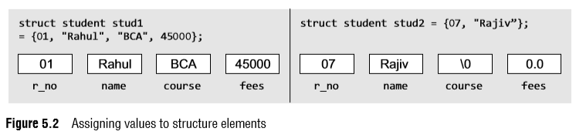
Introduction
Figure 5.2 illustrates how the values will be assigned to individual fields of the structure.
When all the members of a structure are not initialized, it is called partial initialization.
In case of partial initialization, first few members of the structure are initialized and those that are uninitialized are assigned default values.

Slide 12
Introduction
Accessing the Members of a Structure
Each member of a structure can be used just like a normal variable, but its name will be a bit longer.
A structure member variable is generally accessed using a '.' (dot) operator.
The syntax of accessing a structure or a member of a structure can be given as: struct_var.member_name
The dot operator is used to select a particular member of the structure.
For example, to assign values to the individual data members of the structure variable stud1,we may write
stud1.r_no =1;
stud1.name = "Rahul";
stud1.class = " BCA";
stud1.fees = 45000;
To input values for data members of the structure variable stud1, we may write
scanf("%d", &stud1.r_no);
printf("%s",stud1.class);

Slide 13
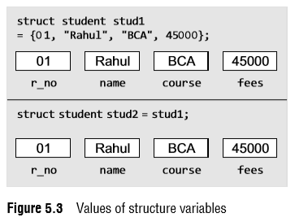
Introduction
Copying and Comparing Structures
We can assign a structure to another structure of the same type.
For example, if we have two structure variables stud1 and stud2 of type struct student given as
struct student stud1={01,"Rahul", "BCA" 45000};
struct student stud2;
Then to assign one structure variable to another, we will write
stud2 = stud1;

Slide 14
Introduction
C does not permit comparison of one structure variable with another.
However, individual members of one structure can be compared with individual members of another structure.
When we compare one structure member with another structure’s member, the comparison will behave like any other ordinary variable comparison.
For example, to compare the fees of two students, we will write if(stud1.fees > stud2.fees) //to check if fees of stud1 is greater than stud2

Slide 15
Nested Structures
A structure can be placed within another structure, i.e., a structure may contain another structure as its member.
A structure that contains another structure as its member is called a nested structure.
Let us now see how we declare nested structures.
Declare the structures separately and then group them in the higher level structure.

Slide 16
Nested Structures
typedef struct
{
char first_name[20];
char mid_name[20];
char last_name[20];
}NAME;
typedef struct { int dd; int mm; int yy; }DATE;
typedef struct {
int r_no;
NAME name;
char course[20];
DATE DOB;
float fees;
} student;
In this example, we see that the structure student contains two other structures, NAME and DATE.

Slide 17
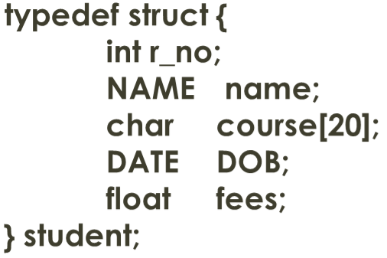
Nested Structures
Both these structures have their own fields.
The structure NAME has three fields: first_name, mid_name, and last_name.
The structure DATE also has three fields: dd, mm, and yy, which specify the day, month, and year of the date.
Now, to assign values to the structure fields, we will write student stud1;
stud1.r_no=1;
stud1.name.first_name="Janak";
stud1.name.mid_name="Raj";
stud1.name.last_name="Thareja";
stud1.course="BCA";
stud1.DOB.dd=15;
stud1.DOB.mm=09;
stud1.DOB.yy=1990;
stud1.fees=45000;
In case of nested structures, we use the dot operator in conjunction with the structure variables to access the members of the innermost as well as the outermost structures.

Slide 18
Arrays Of Structures
Now, we will discuss how an array of structures is declared.
For this purpose, let us first analyze where we would need an array of structures.
In a class, we do not have just one student. But there may be at least 30 students. So, the same definition of the structure can be used for all the 30 students.
This would be possible when we make an array of structures.
An array of structures is declared in the same way as we declare an array of a built-in data type.
struct struct_name
{
data_type member_name1;
data_type member_name2;
data_type member_name3;
.......................
};
struct struct_name struct_var[index];

Slide 19
Arrays Of Structures
Consider the given structure definition.
struct student {
int r_no;
char name[20];
char course[20];
float fees; };
A student array can be declared by writing,
struct student stud[30];
Now, to assign values to the ith student of the class, we will write
stud[i].r_no = 09;
stud[i].name = "RASHI";
stud[i].course = "MCA";
stud[i].fees = 60000;
In order to initialize the array of structure variables at the time of declaration, we can write as follows:
struct student stud[3] ={{01, "Aman","BCA", 45000},
{02, "Aryan", "BCA", 60000},
{03, "John", "BCA", 45000}};

Slide 20
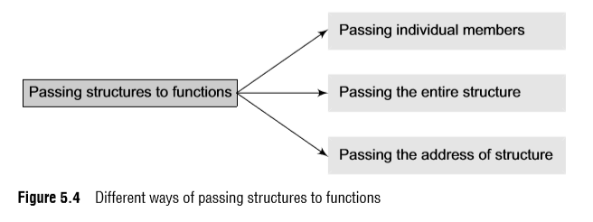
Structures And Functions
For structures to be fully useful, we must have a mechanism to pass them to functions and return them.
A function may access the members of a structure in three ways as shown in Fig. 5.4.

Slide 21
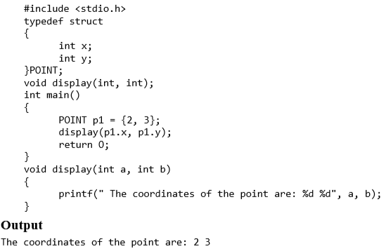
Structures And Functions
Passing Individual Members To pass any individual member of a structure to a function, we must use the direct selection operator to refer to the individual members. The called program does not know if a variable is an ordinary variable or a structured member.

Slide 22
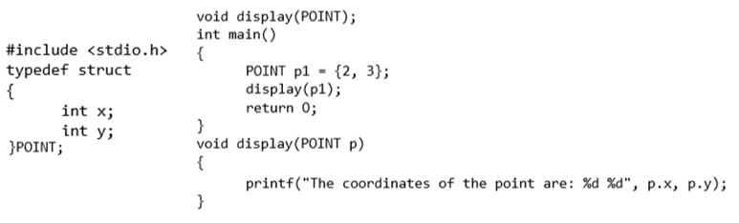
Structures And Functions
Passing the Entire Structure
Just like any other variable, we can pass an entire structure as a function argument. When a structure is passed as an argument, it is passed using the call by value method, i.e., a copy of each member of the structure is made.
The general syntax for passing a structure to a function and returning a structure can be given as,
struct struct_name func_name(struct struct_name struct_var);

Slide 23
Structures And Functions
Passing Structures through Pointers
Passing large structures to functions using the call by value method is very inefficient. Therefore, it is preferred to pass structures through pointers.
It is possible to create a pointer to almost any type in C, including the user-defined types.
The syntax to declare a pointer to a structure can be given as,
struct struct_name {
data_type member_name1;
data_type member_name2;
data_type member_name3;
....................... }*ptr;
or, struct struct_name *ptr;

Slide 24
Structures And Functions
For our student structure, we can declare a pointer variable by writing
struct student *ptr_stud, stud;
The next thing to do is to assign the address of stud to the pointer using the address operator (&), as we would do in case of any other pointer.
So to assign the address, we will write
ptr_stud = &stud;
To access the members of a structure, we can write
(*ptr_stud).roll_no;
C introduces a new operator to do the same task. This operator is known as ‘pointing-to’ operator (->). It can be used as:
ptr_stud->roll_no=01;

Slide 25
Self-Referential Structures
Self-referential structures are those structures that contain a reference to the data of its same type.
That is, a self-referential structure, in addition to other data, contains a pointer to a data that is of the same type as that of the structure.
For example, consider the structure node given below.
struct node
{
int val;
struct node *next;
};
Here, the structure node will contain two types of data: an integer val and a pointer next.

